Slide 1
Manage Apps for Microsoft Teams
NarasimaPerumal Chandramohan

Slide 2
Agenda
App management for the IT Admin Persona of Teams:
How does a global admin go about managing these apps for their organization? How do they make sure to allow or block apps for use by their organization?
How do they ensure apps that are relevant for specific business groups are discoverable by the users within their business groups?
How does a global admin go about publishing apps for their enterprise? How do they manage these apps?

Slide 3
Apps In Teams
1st Party Apps
3rd Party Apps
Custom Apps
Developed by Microsoft
Office 365 or Office workloads
Enable better together scenarios
Not built by Microsoft
Popular work applications
Enabled in central location
Built by your organization
Custom for your business needs
Accessible by users in Teams
Notes:
We start with a quick overview of the types of apps in Teams.
1st Party Apps are those that are published by Microsoft. These are familiar apps like Word, excel powerpoint, and other apps like Bing News, Flows, Dynamics 365 etc.
Other apps are published by other 3rd party vendors. You’ll find several of them on the Teams in-app store.
<Show the store in the app at this point>
Company Apps:
The Microsoft Teams Company App Catalog lets you distribute your line-of-business applications that were built specifically for your organization and that you rely on to complete critical business functions to your users.
Custom apps are apps that are specific to your organization, built and used specifically for users in your organization. Here’s where you’ll find apps that are specific to Microsoft as a company. These apps have been published by the global admins over at the Microsoft IT department
<Show the Microsoft apps in the Teams app store?
With every IT Professional’s focus on security and privacy for cloud or SaaS apps, what controls are we providing organization admins to allow or block these apps? How do admins disable company specific apps if they find issues or bugs with them?

Slide 4
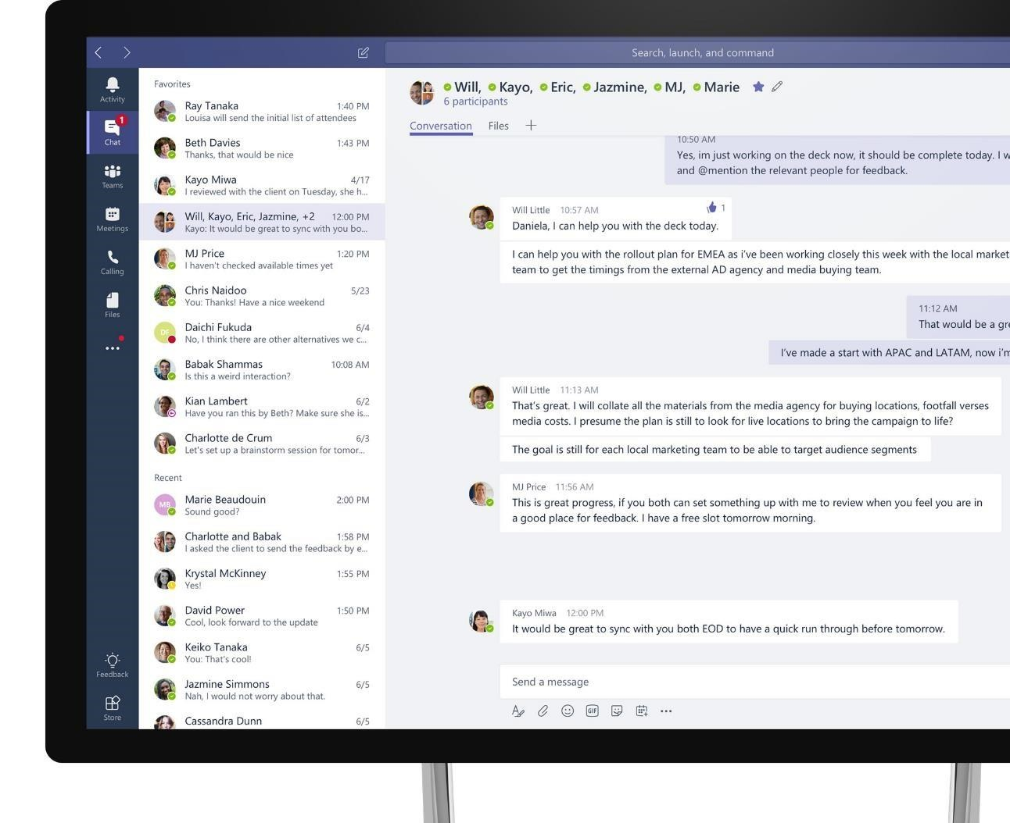
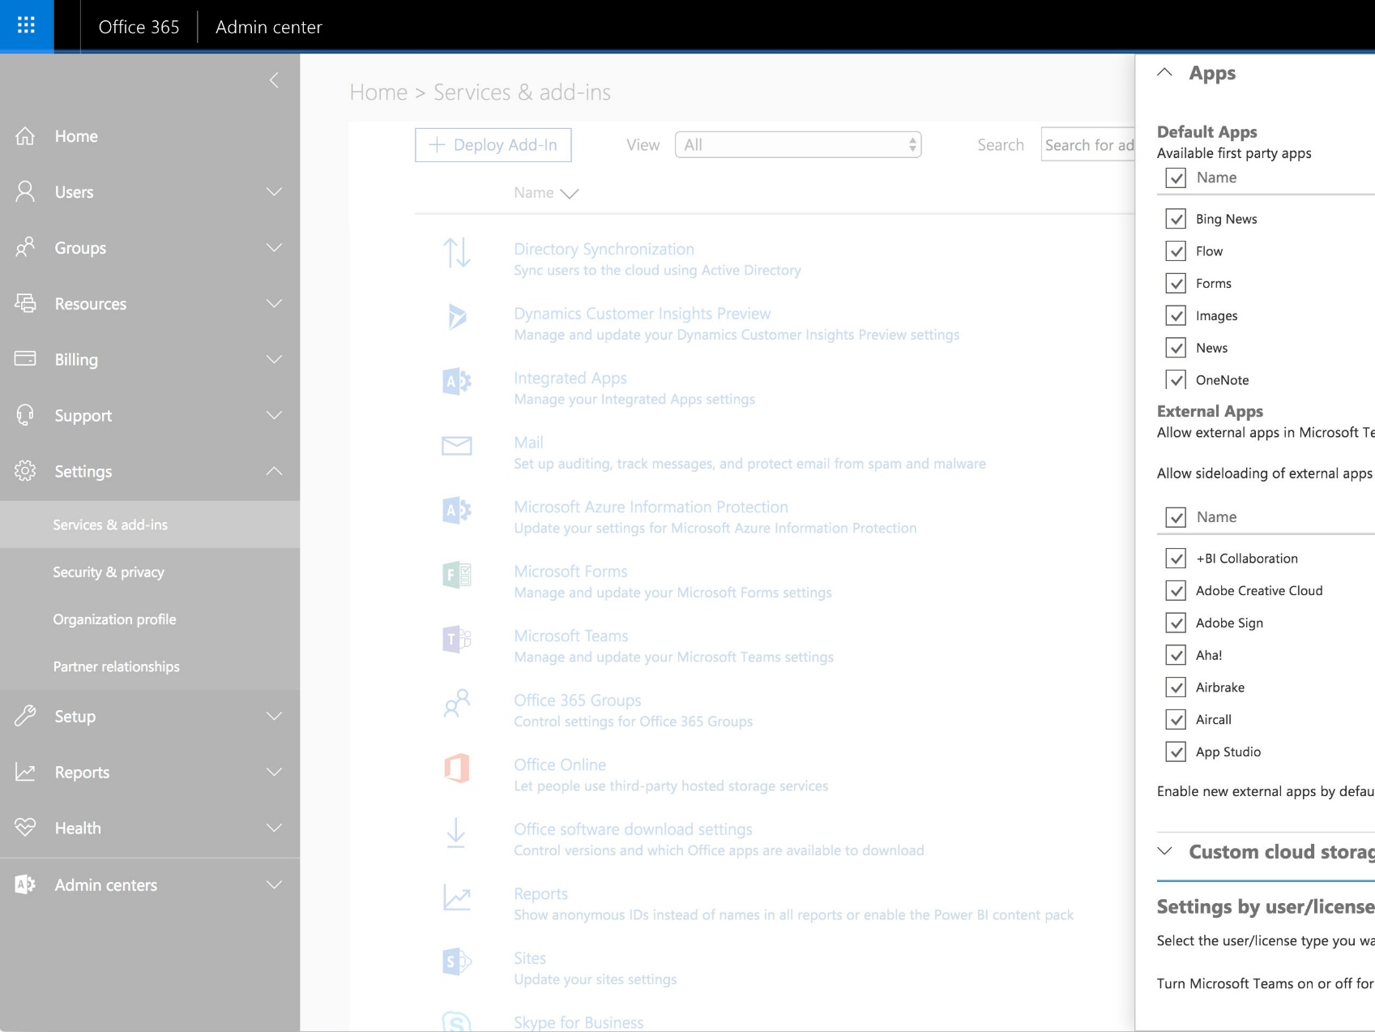
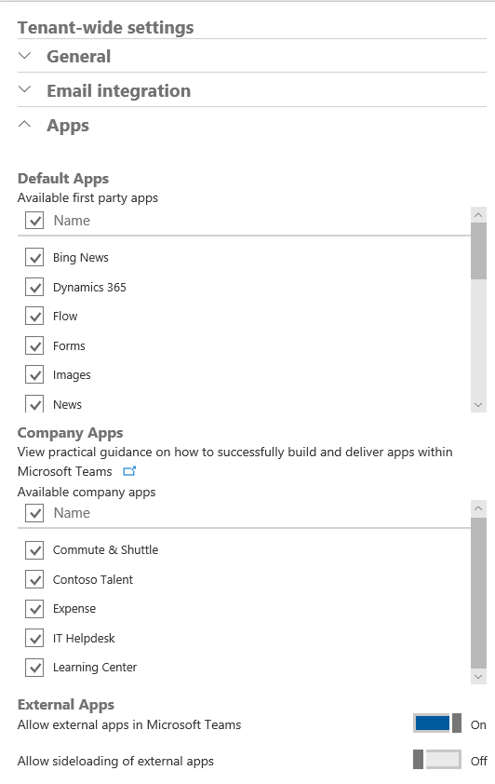



O365 Admin Portal: Old
Managing Apps for the entire Tenant
First Party Apps
Built and hosted by Microsoft
Company Apps
Line of business applications by Customer
External Apps
Built and managed by third-party ISVs
Sideloading
Enables developer and testing apps for Teams
Notes:
Global admins can go to the Office 365 admin Portal to enable or disable apps for their tenant today.
Admins can view the Microsoft published apps, also called the default apps, their own company apps and 3rd party apps(which we call external apps). They can selectively turn on or off apps from each of these categories.
When they turn off apps through this portal, the apps will be blocked and unusable by all users in their tenant.

Slide 5
Policies for Managing Apps
App permission policy Manage which apps are allowed/blocked for users in my organization
Microsoft apps
Third-party apps
Enterprise apps
App setup policy Manage how the apps show up in Teams client
Pinned apps in the app bar
Delegation of upload of custom apps
Notes:
We will be introducing Policies shortly.
The App Permission policy will allow the global admin to manage what apps are allowed or blocked for users in an organization.

Slide 6
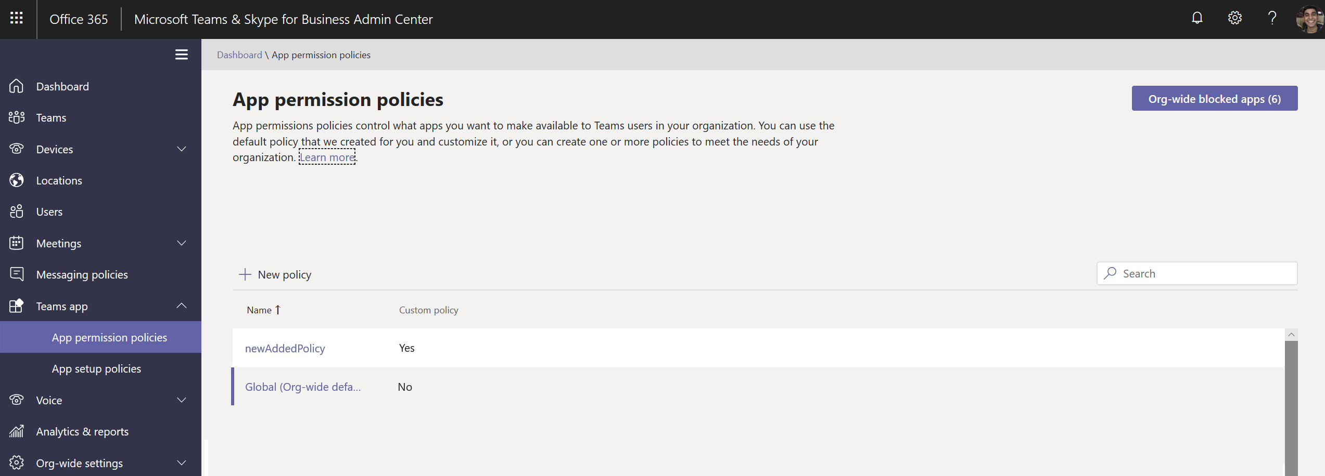
Notes:
To view any current settings you may have, click on Org-wide blocked apps.
This will present your existing settings from the old Office 365 portal.
When you’re ready to begin using policies.
Edit the global policy to determine usage of apps for all users in your tenant by default.

Slide 7
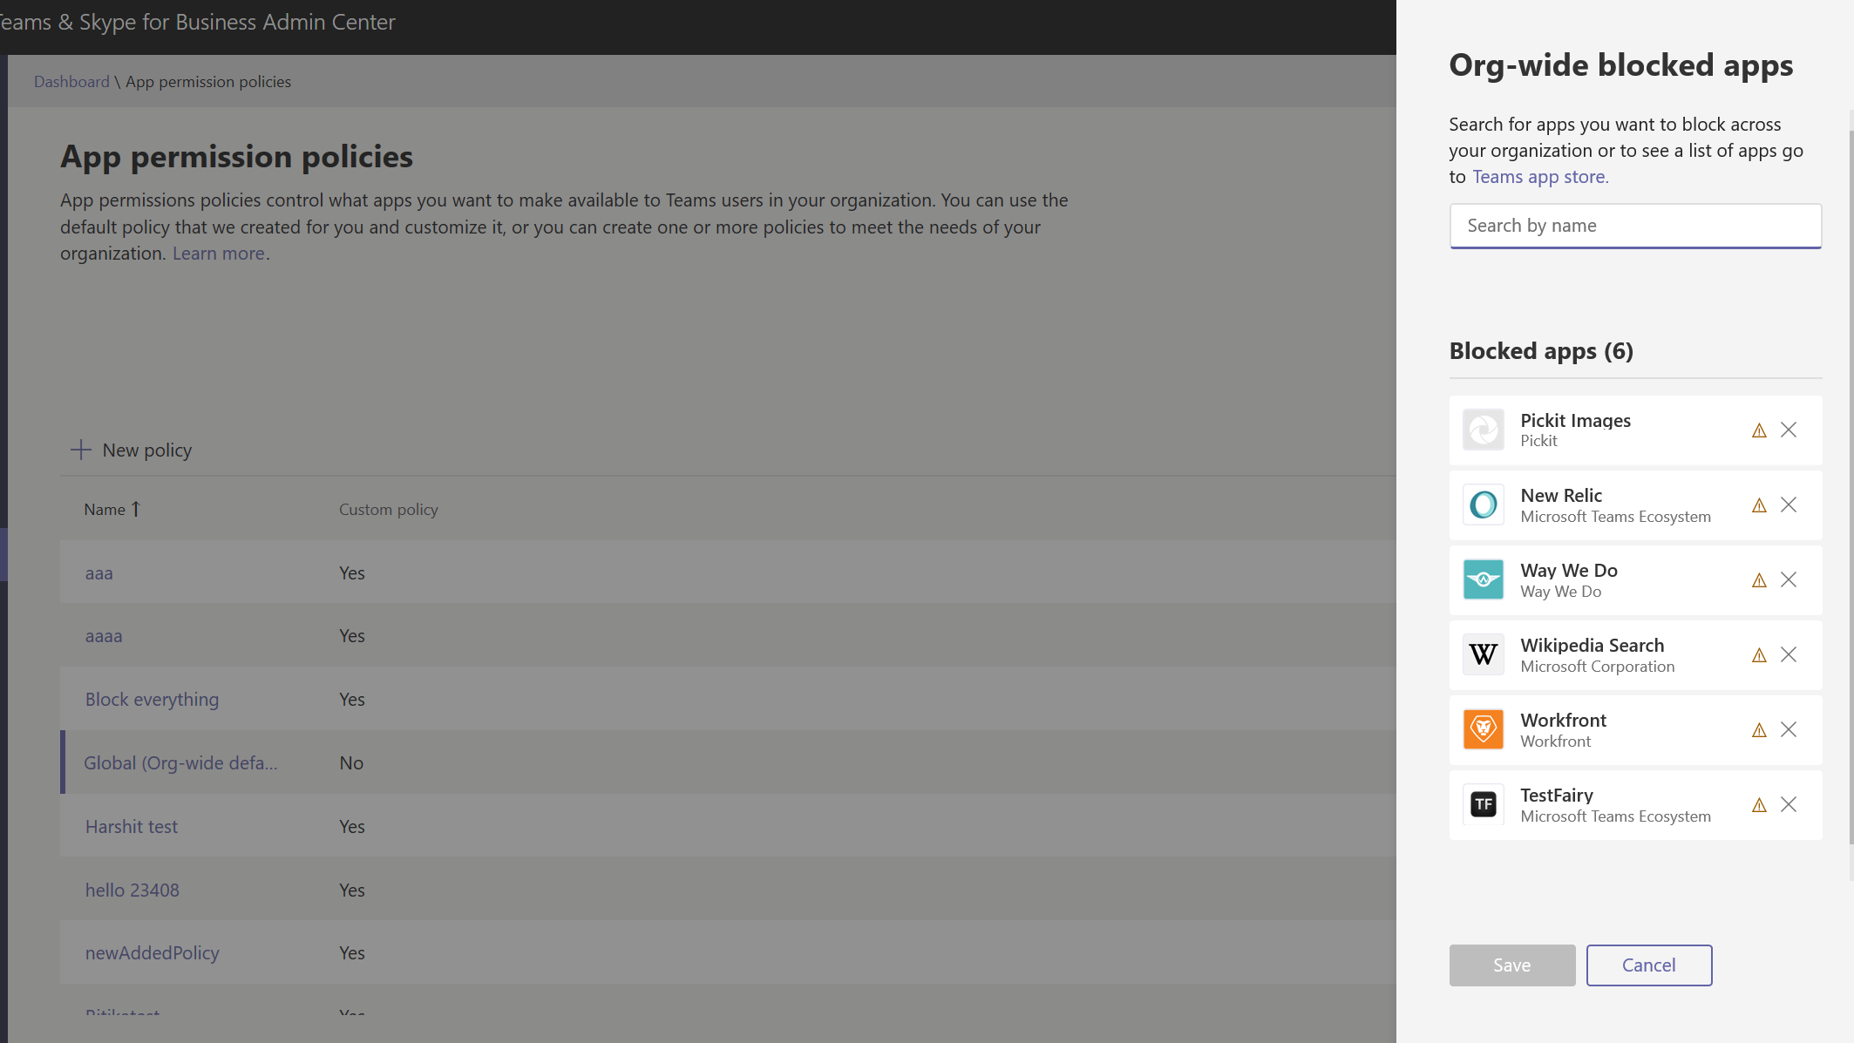
Notes:
To view any current settings you may have, click on Org-wide blocked apps.
This will present your existing settings from the old Office 365 portal.

Slide 8
Notes:
When you’re ready to begin using policies
Edit the global policy to determine usage of apps for all users in your tenant by default.

Slide 9
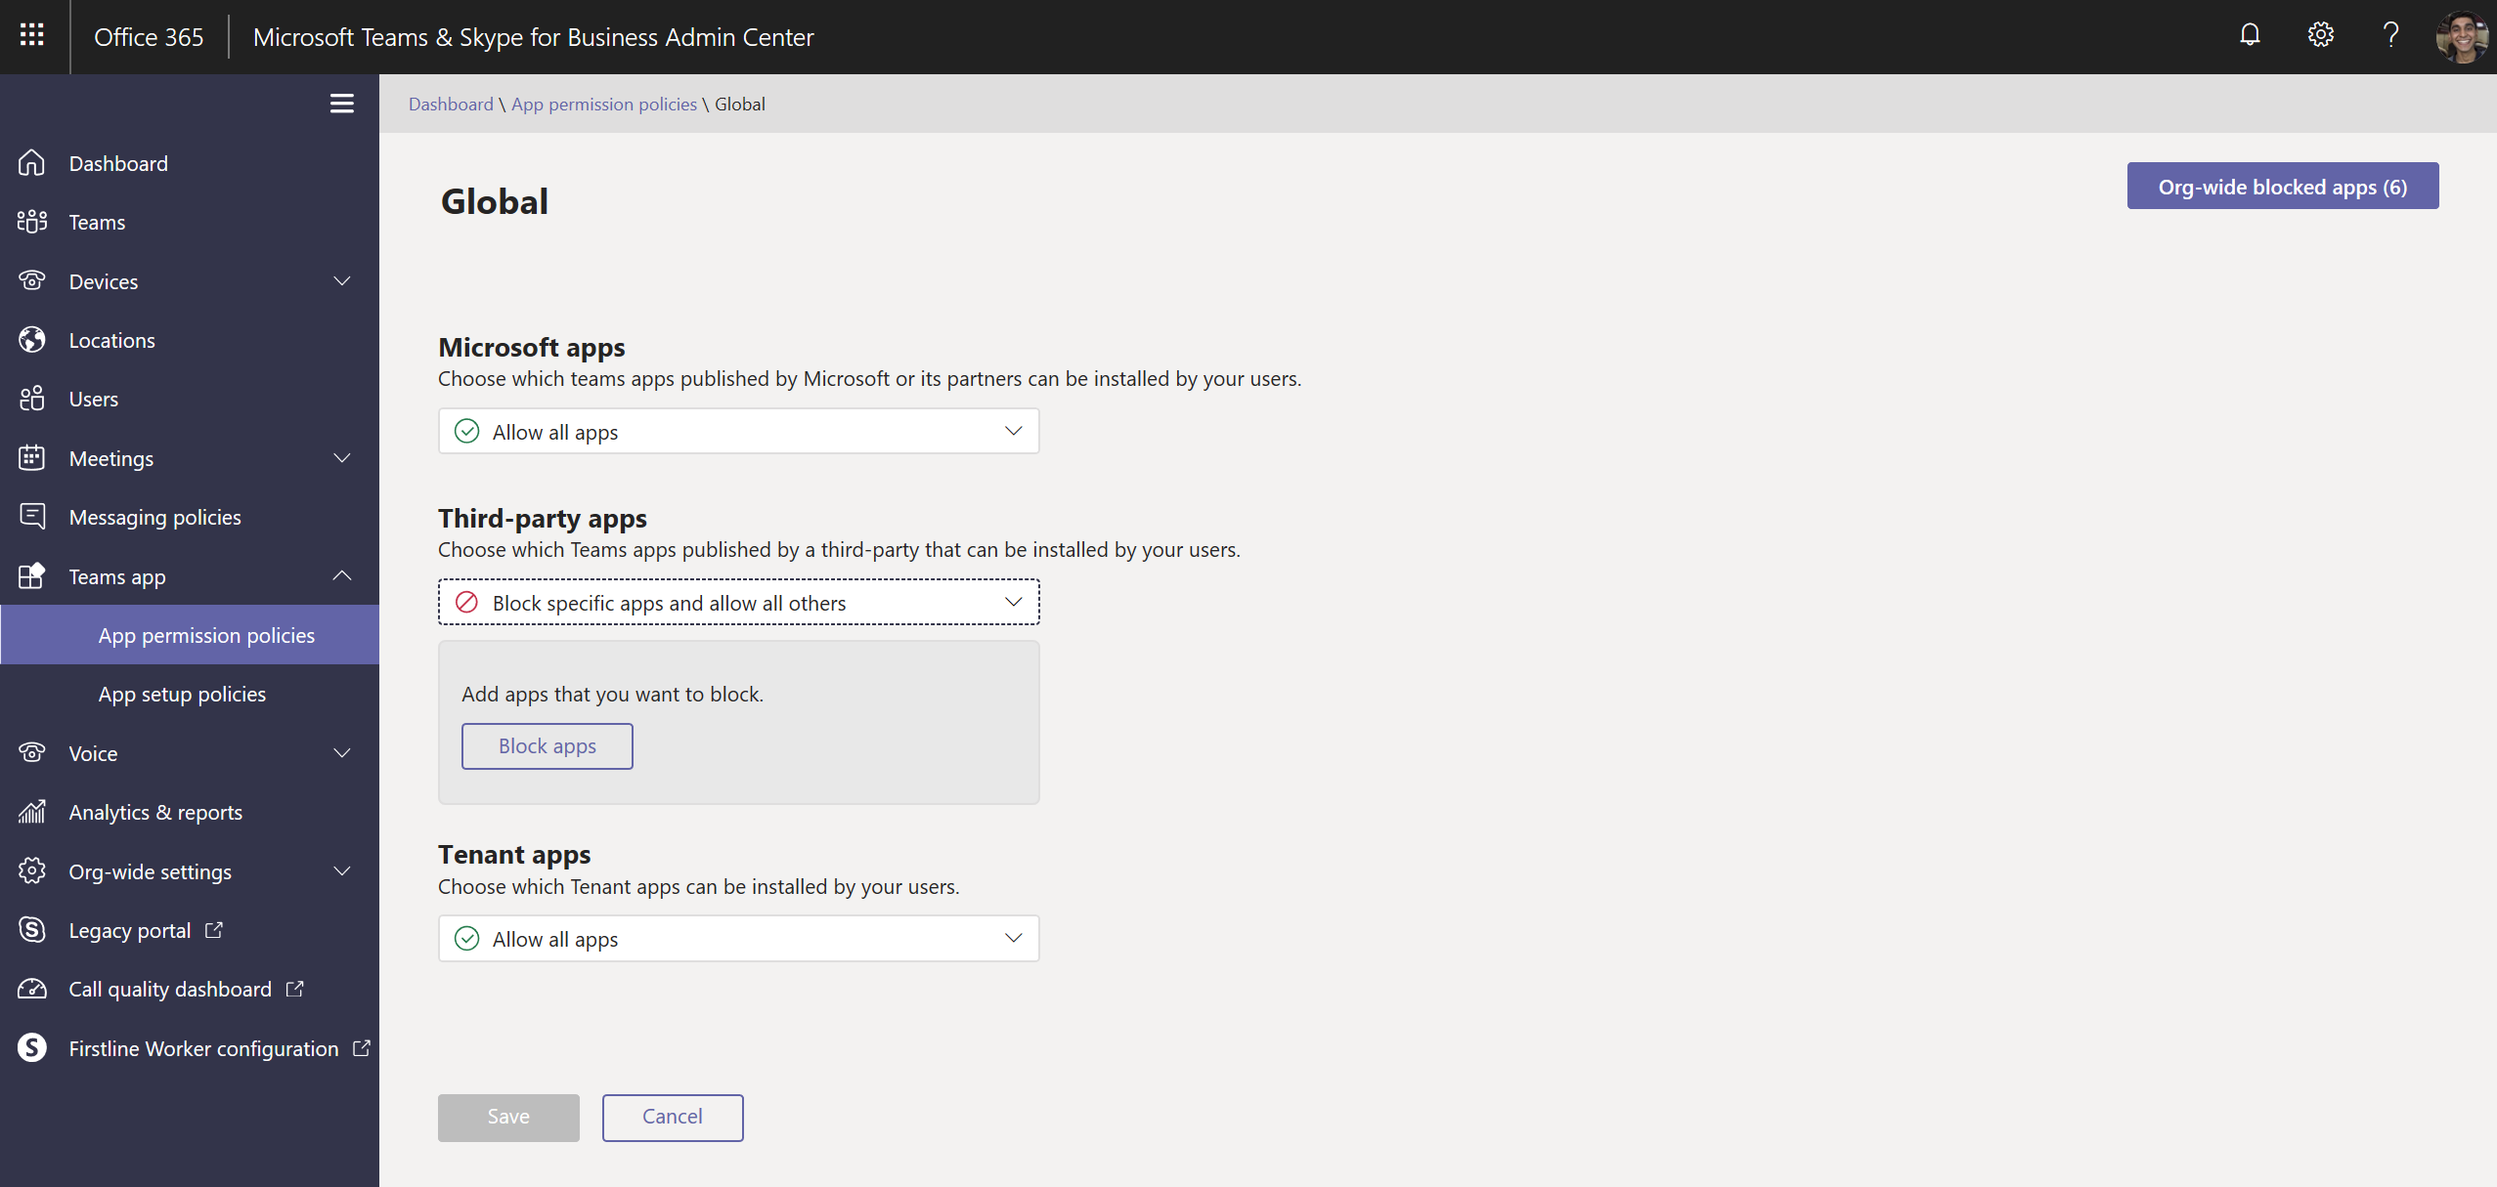
Notes:
To see the various combinations of allow-block, click on the drop-down

Slide 10
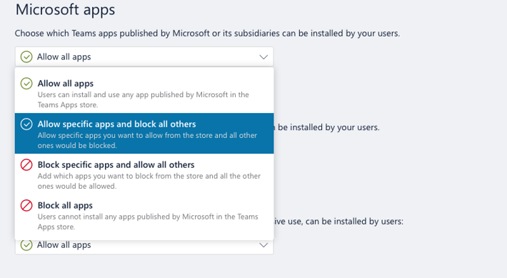
Notes:
<>

Slide 11
Notes:
When you select block specific, click on block apps to pick the list of apps you want to block

Slide 12
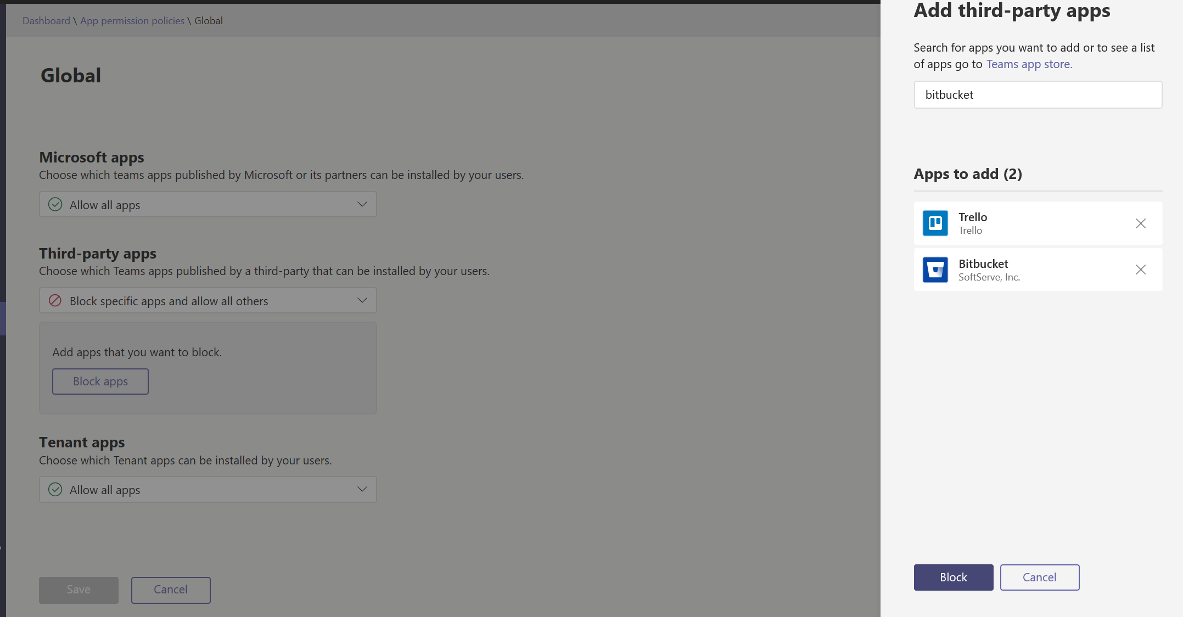

Slide 13
Notes:
You can click on +New Policy to create a custom Policy.

Slide 14
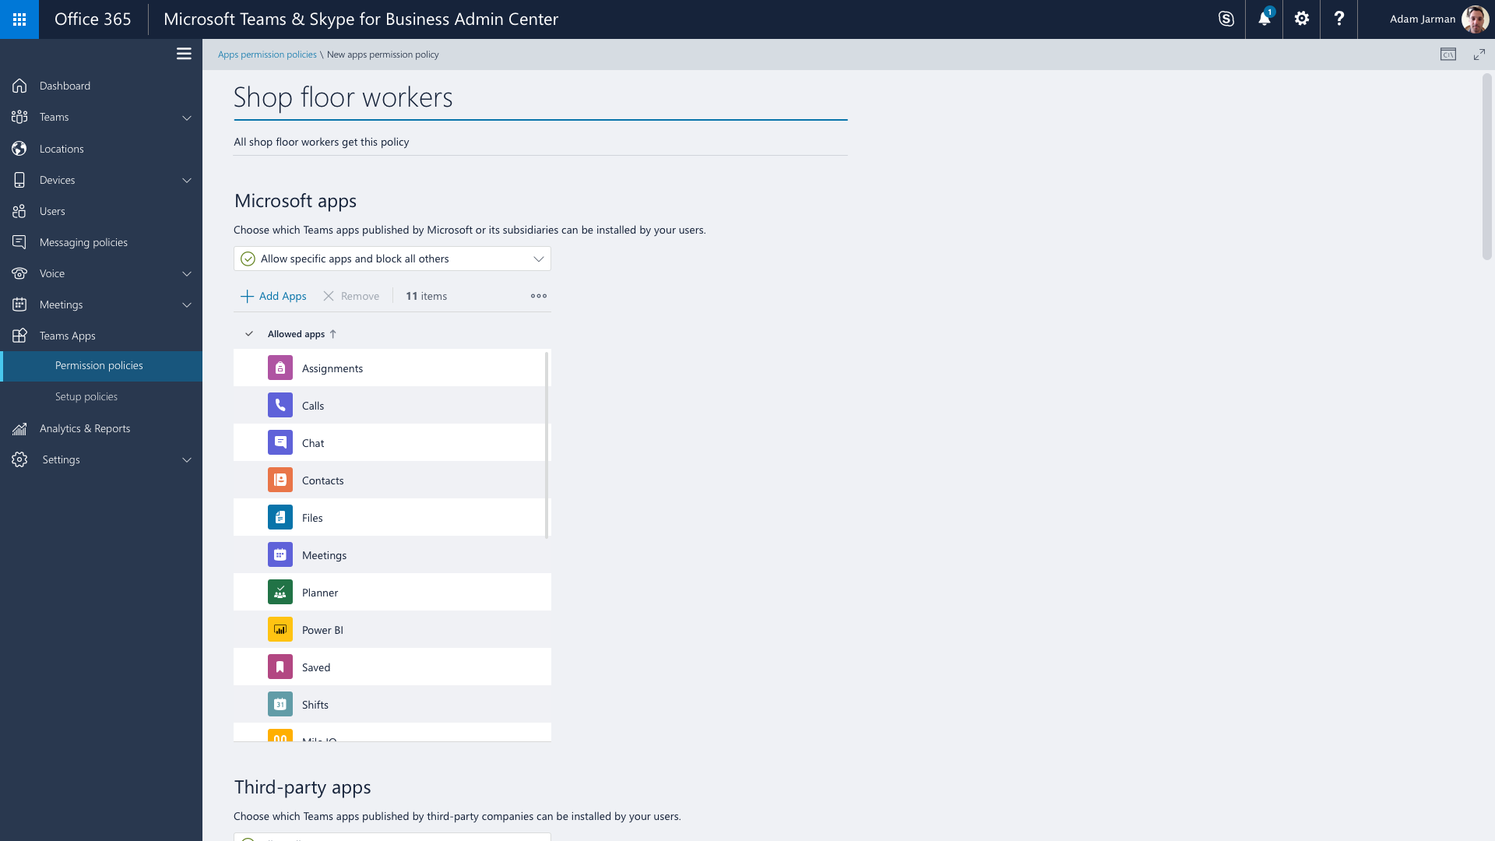

Slide 15
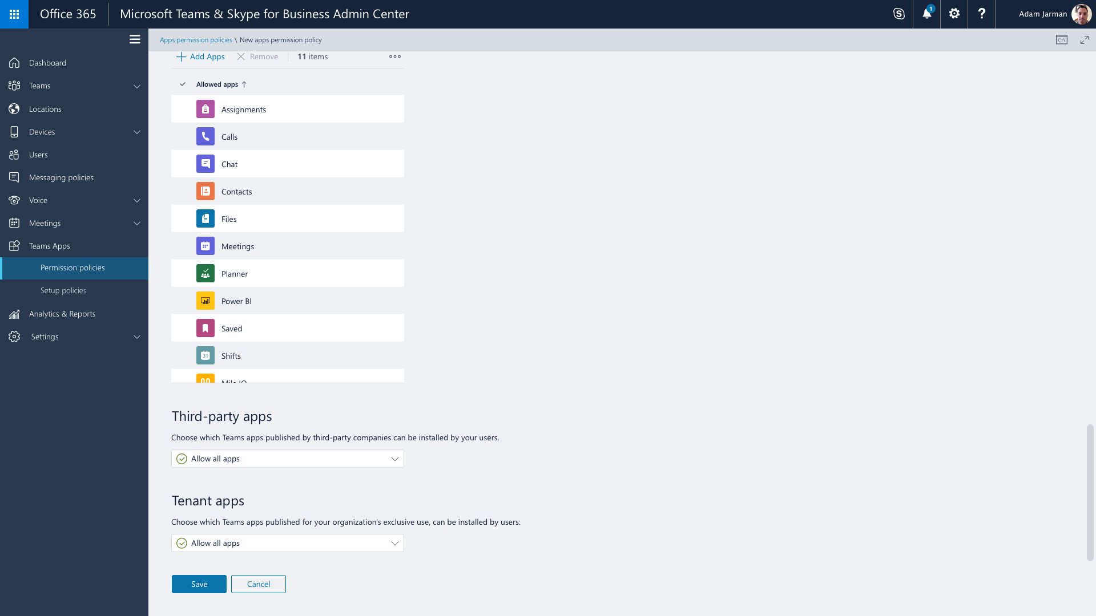

Slide 16
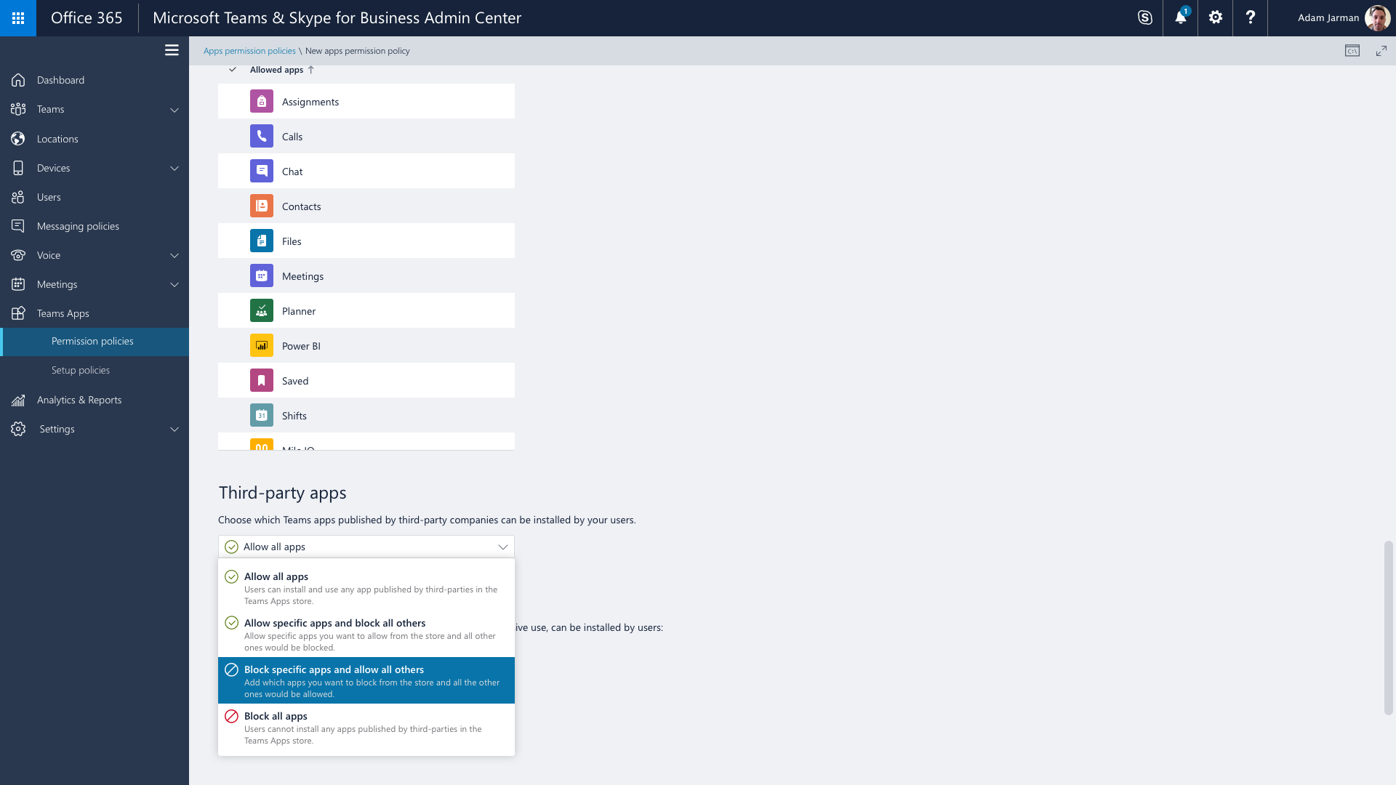

Slide 17
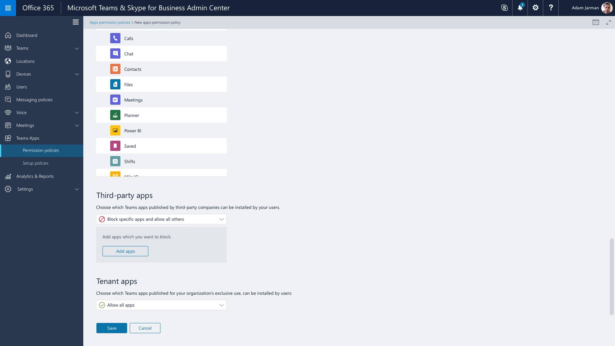

Slide 18
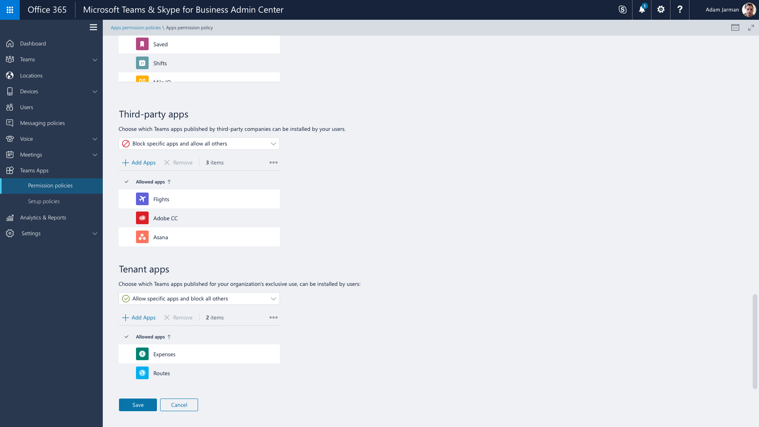

Slide 19
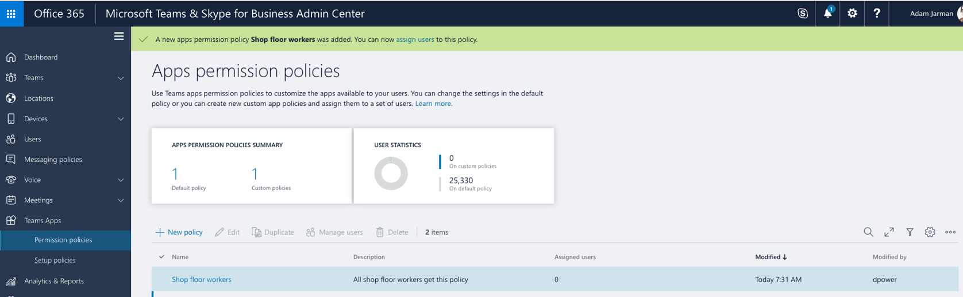
Notes:
You can now assign this newly created policy by clicking on users, selecting a specific user and assigning the policy to them.

Slide 20
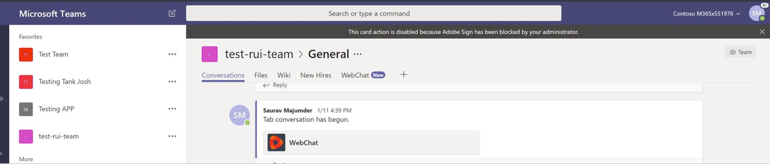
Notes:
On the client,
If the user already has the app installed, here’s what they’ll see if they try to interact with the app.
If the user has not yet installed the app, they will not be able to discover the app in the Teams app store

Slide 21
Policies for Managing Apps
App permission policy Manage which apps are allowed/blocked for users in my organization
Microsoft apps
Third-party apps
Enterprise apps
App setup policy Manage how the apps show up in Teams client
Pinned apps in the app bar
Delegation of upload of custom apps
Available in Feb
Coming soon
Coming soon!
Notes:
What you just saw helps you answer the following questions:
How does a global admin go about managing apps for their organization? How do they allow or block apps for their entire organization?
And in the near future, how will they block or allow apps for specific users within their organization?
Now onto the next question:
How to admins make sure to provide good discoverability for apps they deem are important for specific users in their organization.
Lets look at the app setup policy for this.

Slide 22
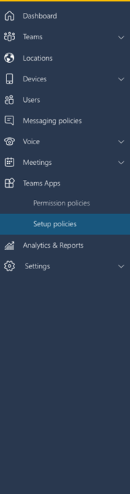
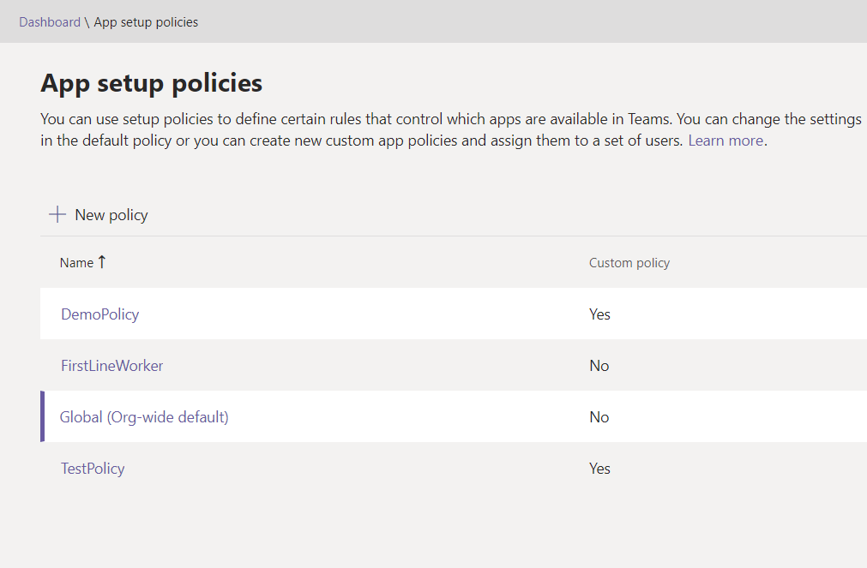
Improving discoverability of apps
With App setup policies
Notes:
The app setup policy enables global admins to create policies that determine the set of apps and their sequence that should be pinned to the app bar. They can create such policies for HR, or Finance and assign them to users within the respective business group.
This helps improve discoverability of these apps for users for which such apps are deemed relevant.
Lets have a look at the app-setup policy

Slide 23
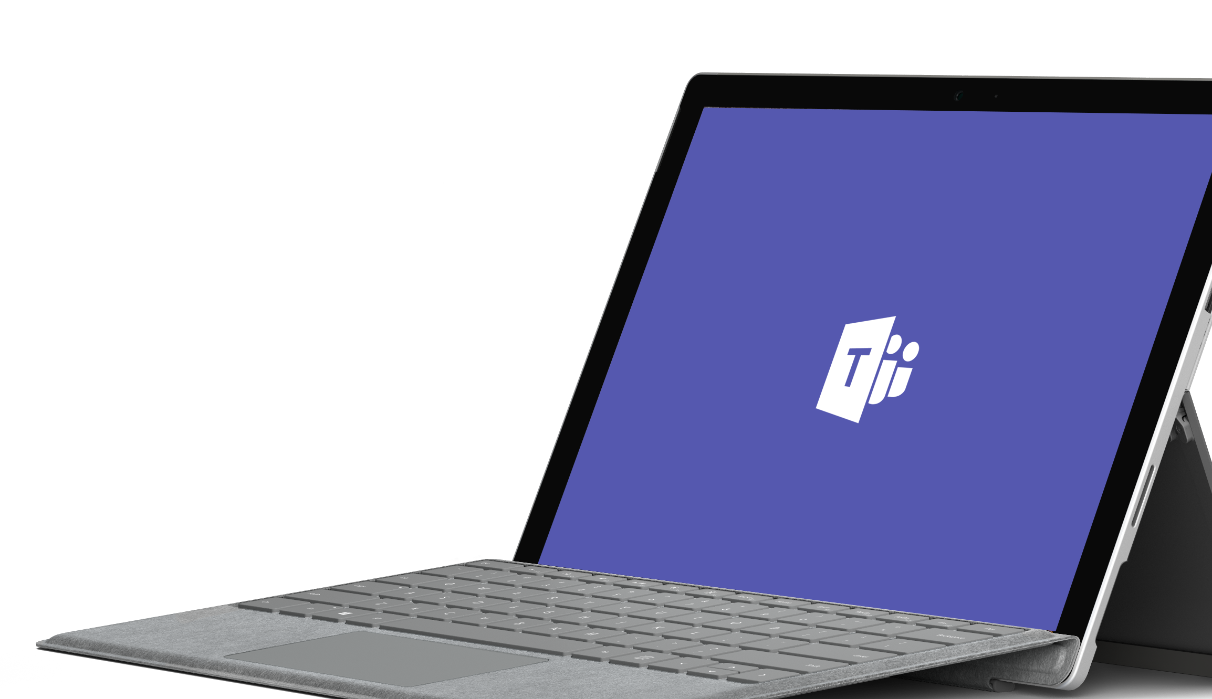
Demo
Notes:
Demo:
Global policy in the modern portal
Global policy on a user’s desktop
Create a custom policy:
Activity
Trello
Jira Cloud
GitHub
Polly
Smartsheet
Adobe Sign

Slide 24
Get started today: https://graph.Microsoft.com
Docs: https://aka.ms/teamsgraph/v1
Feedback:
UserVoice
Stack Overflow

Slide 25
Next steps
Resources
Get started Start using Microsoft Teams today
Get technical with Microsoft Teams Development Education series
Play with hands-on-labs
Join the Teamwork Solution Accelerator for Partners
Access resources & support Get Teams deployment & adoption support from
FastTrack
https://aka.ms/SuccessWithTeams
Teams Dev center: https://aka.ms/TeamsDeveloper
Developer support: https://aka.ms/TeamsDevSupport
Teams Dev docs: https://aka.ms/TeamsDevDocs

